Slide 1

Rethinking Learning Pathways:
How to Equip Students and Graduates for the Workforce of Tomorrow

Slide 2

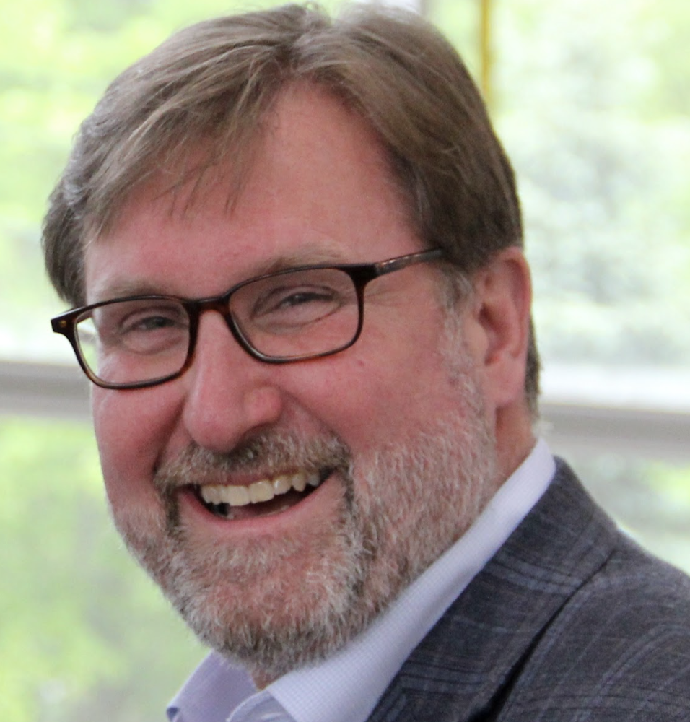
Today’s speakers:
Jim Fong
Peter Janzow
Chief Research Officer
UPCEA
VP North America, Strategic Accounts
Pearson

Slide 3


Traditional Education On the Decline (Hechinger Report; Inside Higher Ed)
Higher education must change to focus in on the new learners and adapt to their unique situations…
Enrollment for UG and graduate students decreased by 4.1% in 2022 compared to 2021.
Traditional Education
More than 4 in 10 bachelor’s degree holders under 45 did not agree that the benefits of education exceeded the costs.
Just 6 in 10 Americans recently surveyed stated that college is worth the time and money.
The proportion of 14- to 18-year-olds who think postsecondary education is necessary dropped 15%.
The number of high school graduates enrolling in college has decreased 7% (from 70% to 63%) nationwide.
The inflation-adjusted average cost of a 4-year college education has doubled since 1974 and is up 66% for a 2-year.
Source: https://hechingerreport.org/how-higher-education-lost-its-shine/
https://www.insidehighered.com/views/2022/08/16/higher-ed-must-change-or-die-opinion#.YvuaxFJCI2Y.linkedin

Slide 4
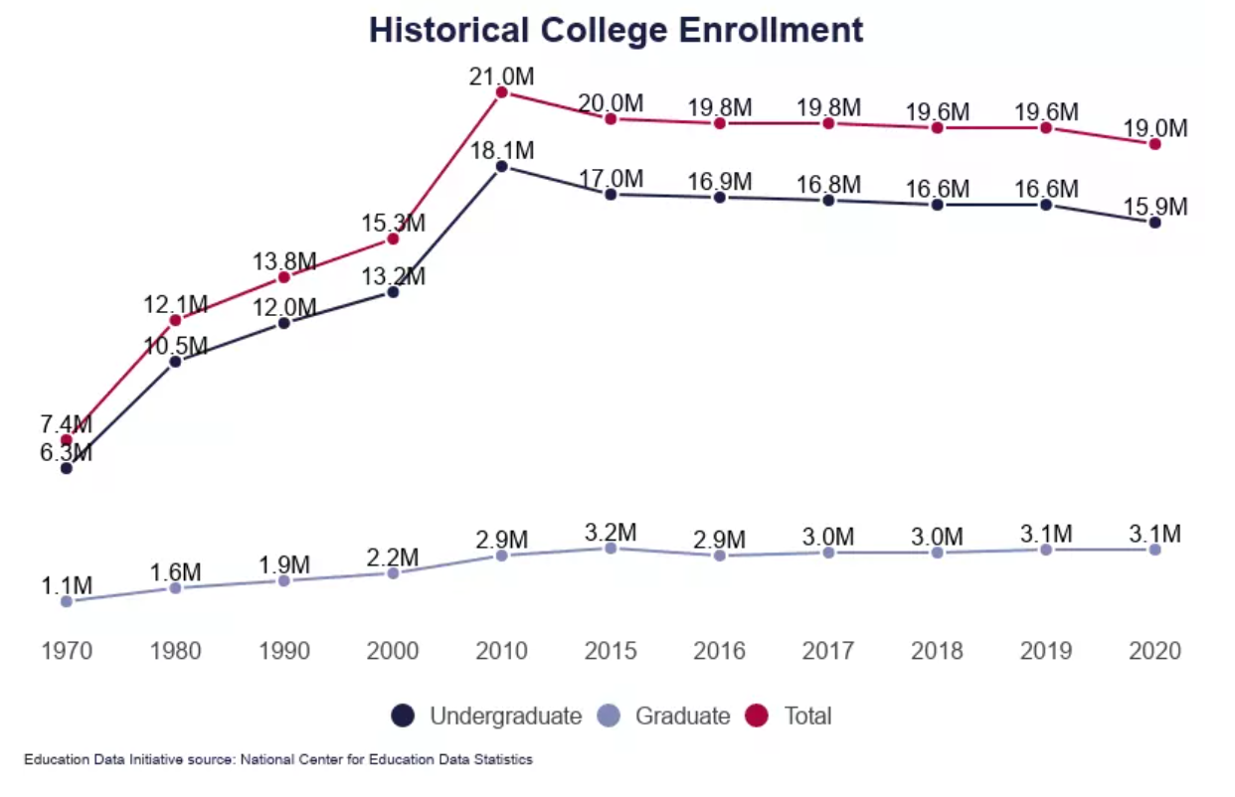
Traditional College Education Has Struggled Over the Past Decade

Slide 5
Despite Favorable High School Graduation Rates and Volume of Students…

Slide 6
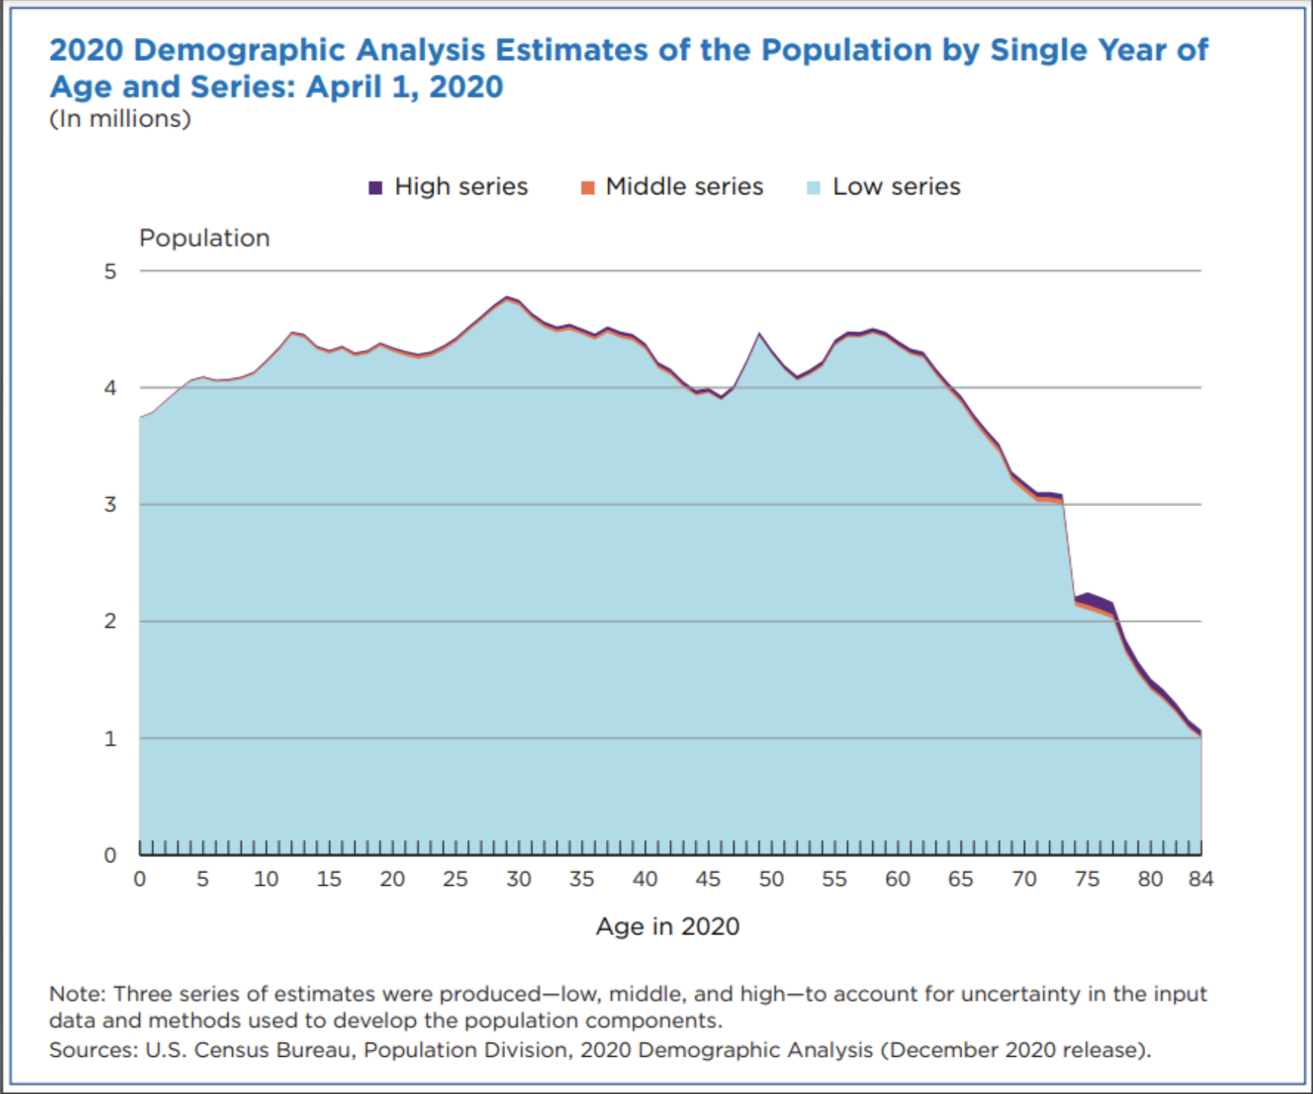

Slide 7
Is Higher Education Chasing the Right Group?
Highlighting the new adult learner population for higher-educational market opportunities…
Marketable New Adult Learners vs. Traditional Student Population
1
Million
Million
3
Million
New Adult Learners
Million
2
Million
# of Adults:
*in millions
Source: Census Bureau
Source: National Student Clearinghouse

Slide 8






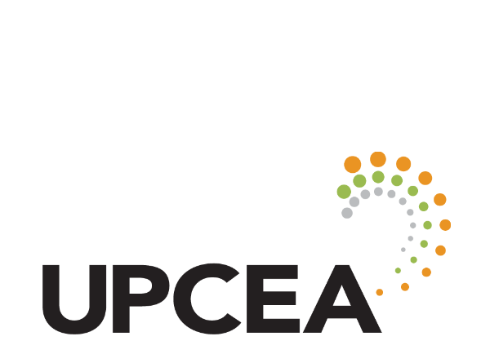
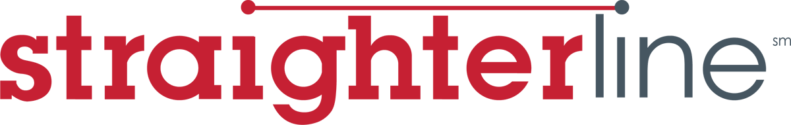
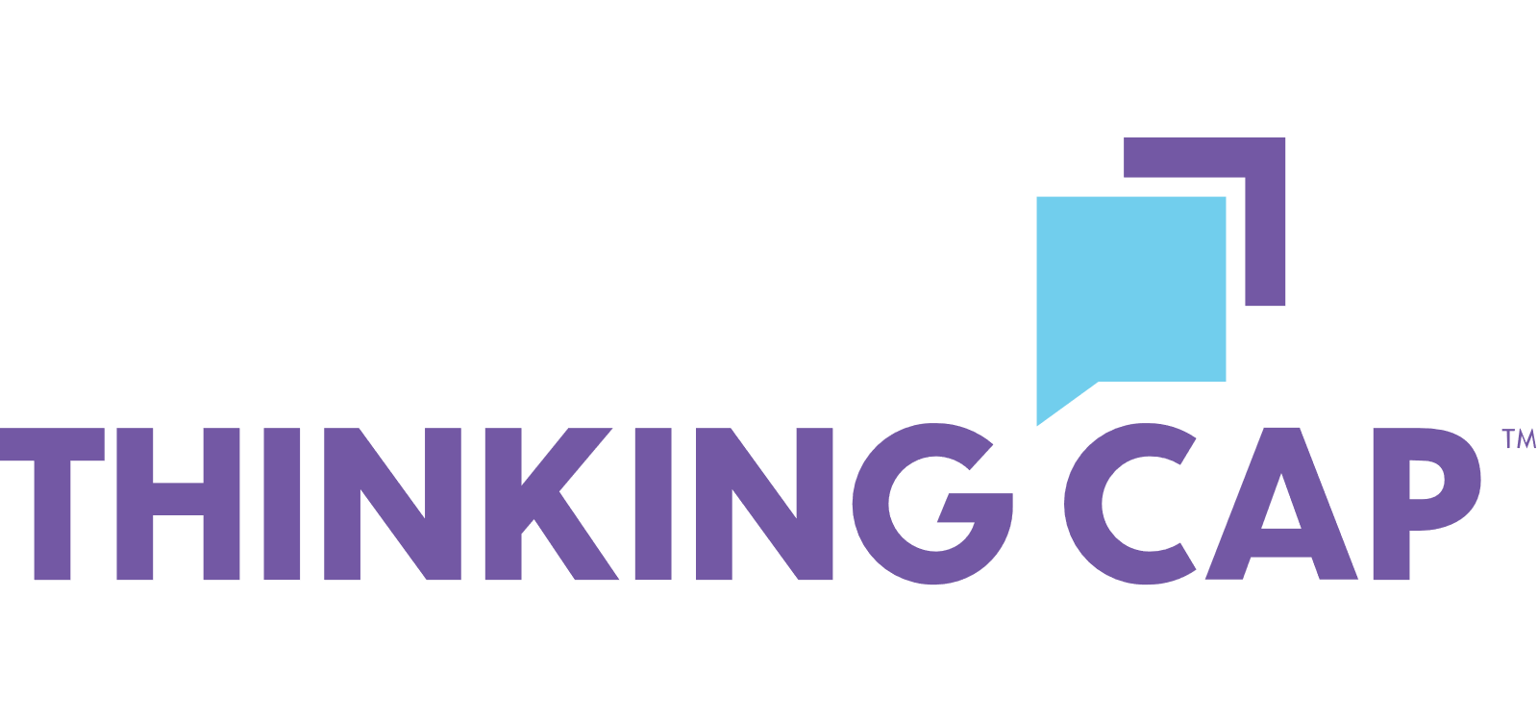
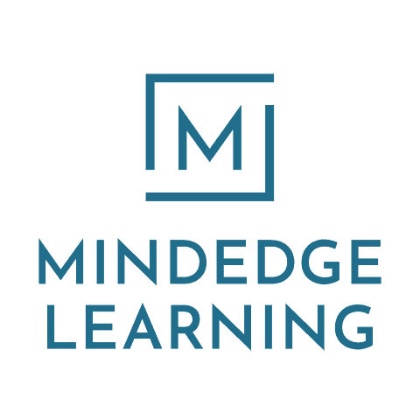
Who Are Our New Adult Learners? Not Everyone Wants a Degree
Disengaged Learner
(some college, no degree)
Kaylie (23)
Gen Z/Young Mill’l
Mateo (19)
Gen Z/Young Mill’l
Carla (28)
Mid-Millennial
Chris (31)
Mid-Millennial
Shauna (42)
Millennial/Gen X’er
Phil (37)
Millennial+
Associates Degree
Didn’t complete college
Graduate Degree
High School/GED
Bachelor's Degree
Bachelor’s Degree
Full-time hotel front-desk rep
Part-time retail service rep
Team manager in a large telecom firm
Between career paths, seeking employment
Sales rep at a large pharma company
Government contractor
New Adult Learner
Valentina (21)
Gen Z
Max (22)
Gen Z
Elise (24)
Young Millennial
Chen (25)
Young Millennial
Carla (28)
Mid-Millennial
Chris (31)
Mid-Millennial
Customer-Service Rep
Mechanics Contractor
Team Manager
Executive Assistant
Public Service Rep
Technician
Mature Adult Learner
Madeline (52)
50 to 55 years-old
Employed full-time
Joshua (57)
56 to 60 years-old
Unemployed
Norman (63)
61 to 65 years-old
Retired in 2020
Lisa (71)
Over 65 years-old
Retired in 2012

Slide 9
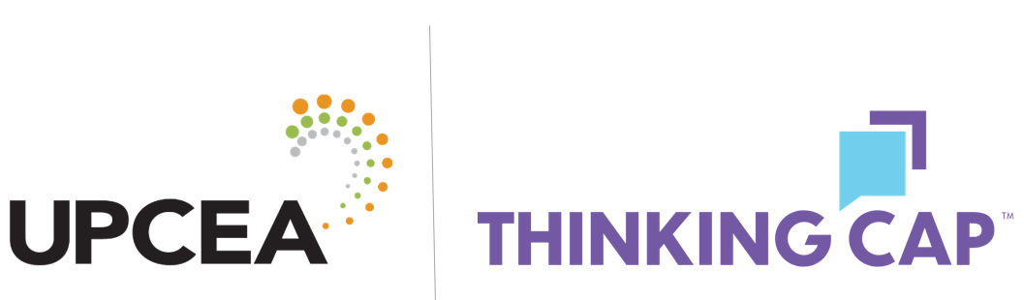
How Do They Differ?
 | Kaylie (23) | Mateo (19) | Carla (28) | Chris (31) | Shauna (42) | Phil (37)
Employed | 62% | 81% | 53% | 77% | 54% | 79%
Interested in Personal Advancement (% Extremely/Very Interested) | 55% | 60% | 56% | 74% | 37% | 52%
Higher Education Provides A Positive ROI (% Strongly Agree/Agree) | 69% | 85% | 79% | 83% | 81% | 77%
Colleges and Universities Can’t Keep Up with the Economy (% Strongly Agree/Agree) | 61% | 53% | 54% | 63% | 47% | 57%
Stackable Credentials Provide Greater Value (% Strongly Agree/Agree) | 66% | 60% | 74% | 72% | 60% | 75%
Preparedness for Entering the New Economy (% Extremely Prepared) | 18% | 16% | 13% | 18% | 12% | 22%
Comfortability Gathering Information Online (% Extremely Comfortable) | 27% | 24% | 34% | 32% | 32% | 34%
Motivation: Advance Career (% Primary Motivation) | 23% | 27% | 33% | 36% | 36% | 22%
Motivation: Increase Salary (% Primary Motivation) | 12% | 29% | 20% | 33% | 23% | 22%
Motivation: Gain Knowledge (% Primary Motivation) | 14% | 13% | 13% | 12% | 12% | 19%
Motivation: Better Oneself (% Primary Motivation) | 14% | 11% | 15% | 15% | 10% | 19%

Slide 10






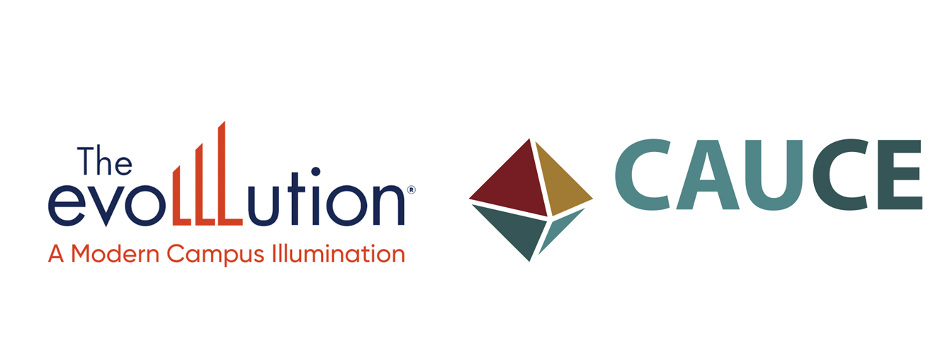
Creating an Integrated and Strategic Portfolio
80% of employers say a stackable model would increase their organization’s interest in non-degree or alternative credentials
Source: UPCEA & Colleges - The Effect of Employer Understanding and Engagement on Non-Degree Credentials
60% of institutions disagree that continuing education offerings are well integrated into the institution’s portfolio of traditional offerings
Source: UPCEA, The EvoLLLution, CAUCE 2023 State of Continuing Education (Report not yet released).

Slide 11
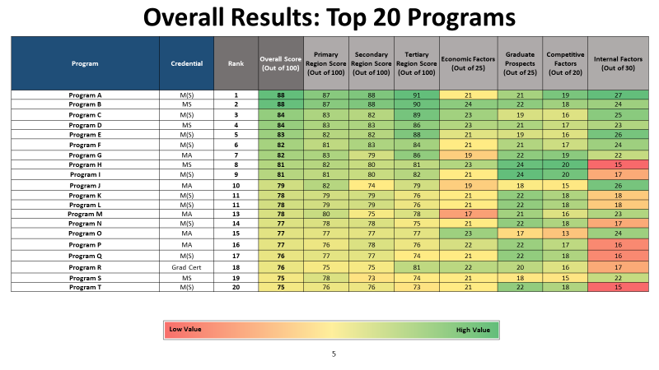

Slide 12
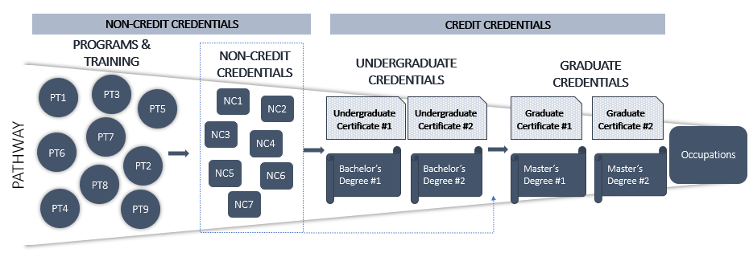
Stackable Pathway

Slide 13
Natural and Agricultural Sciences Occupational Mapping Data
The table below displays the OOM rank and expected growth for each popular occupation that could connect to potential programming opportunities. These datapoints help to better understand market potential for a proposed program.
Occupation | OOM Rank | Jobs in the Primary Region (2022) | Expected 10-YR Growth in the Primary Region | Average Annual Openings in the Primary Region
Data Scientists | 30 | 19,096 | 4,241 | 1,915
Database Administrators | 52 | 8,975 | 963 | 780
Surveyors | 55 | 4,578 | 250 | 425
Network and Computer Systems Administrators | 61 | 32,259 | 2,166 | 2,372
Life, Physical, and Social Science Technicians, All Other | 64 | 12,064 | 685 | 1,578
Computer Systems Analyst | 81 | 64,381 | 4,586 | 5,119
Agricultural Inspectors | 86 | 2,424 | 91 | 406
Forest and Conservation Technician | 90 | 6,585 | -24 | 813

Slide 14
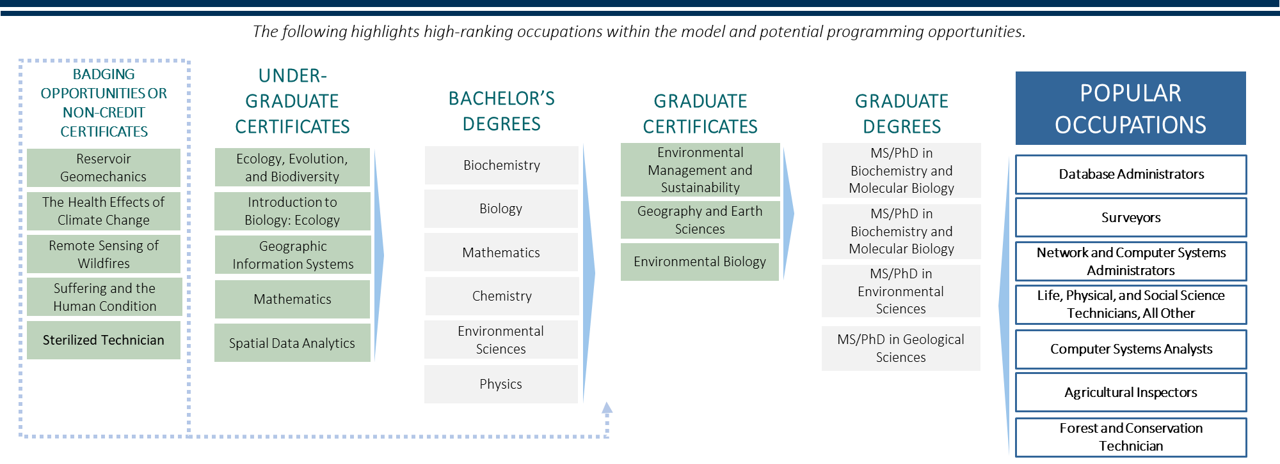
Natural and Agricultural Sciences Occupational Pathways
Current University X
program offerings
Recommended University X program offerings

Slide 15
Introducing Pearson Workforce Skills

Slide 16
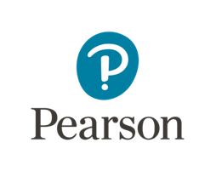
Pearson Workforce Skills
Learn
Faethm by Pearson Strategic workforce planning tools and consulting expertise to help future-proof jobs and programs, considering the impact of automation and change | TalentLens Pre-hire and at-work assessments to provide insights into aptitude, soft skills, personality and motivation for each person
Assess
GED Works GED Diploma programs for working learners, provided through their employers | Accelerated Pathways Capabilities to help employers and employees access learning and upskilling experiences through Tuition Management and other programs
Credential, Verify and Connect
Credly The largest and most-connected digital credential network, best of breed digital credentials. Unlocking opportunities for employment and degree completion.

Slide 17

Trends and emerging issues for alternative credentials

Slide 18
Topics
How widespread is adoption of standardized digital credentials?
Where does Higher Ed fit in the emerging skills-based economy?
HolonIQ 2023 Report
Implications of Skills-based Talent approaches
New standards for professional certificate outcomes are on the horizon
What problems can we work together to overcome?
Q&A
Resources for further exploration

Slide 19
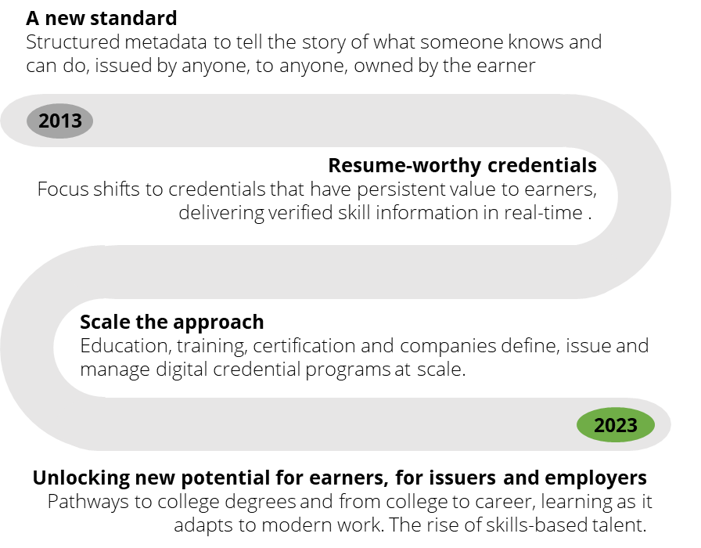
It’s been a decade for standardized digital credentials
Some key lessons we’ve learned
The standard is widely adopted for all types of learning and skills assertions
Structured data enables machine-readability
Earners own their data
Brands are important
Value is driven by intentional design
Verification matters – to a point
It’s all about trust

Slide 20

The Credly Network, by the Numbers
65M+
Credentials
33M+
Earners
1 Million
Credentials shared each month
4.5 M
Visitors per month

Slide 21
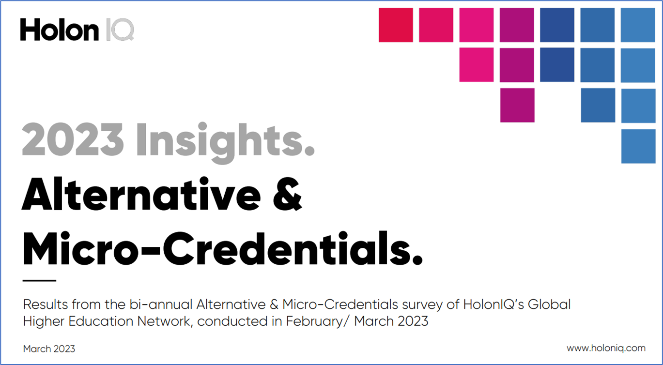
Impressions from Higher Education –
HolonIQ 2023 report

Slide 22
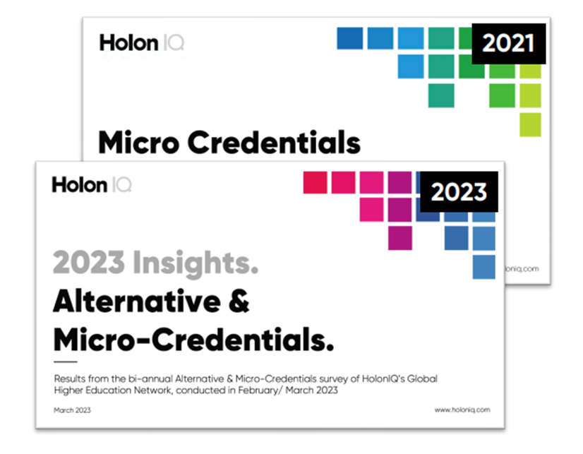
Tracking Alternative & Micro-credentials
Education leaders representing universities and other higher education institutions, along with government, industry and EdTech stakeholders provided their insights and experiences about micro and alternative credentials.
Research was conducted in February – March 2023, and findings are compared with HolonIQ’s survey from February – March 2021.

Slide 23
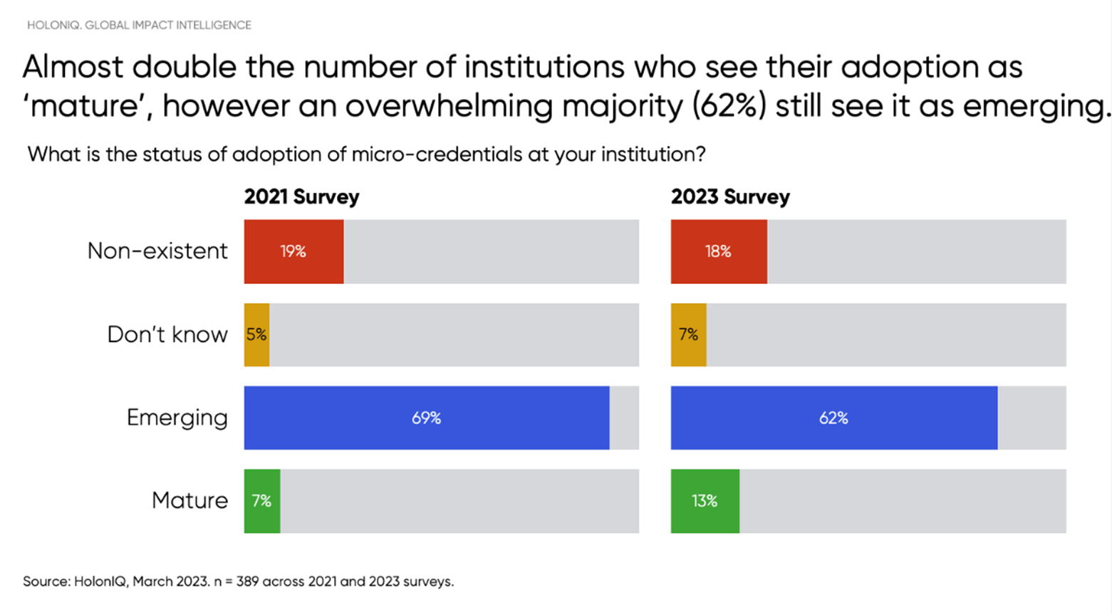
Higher education micro-credentials still emerging

Slide 24
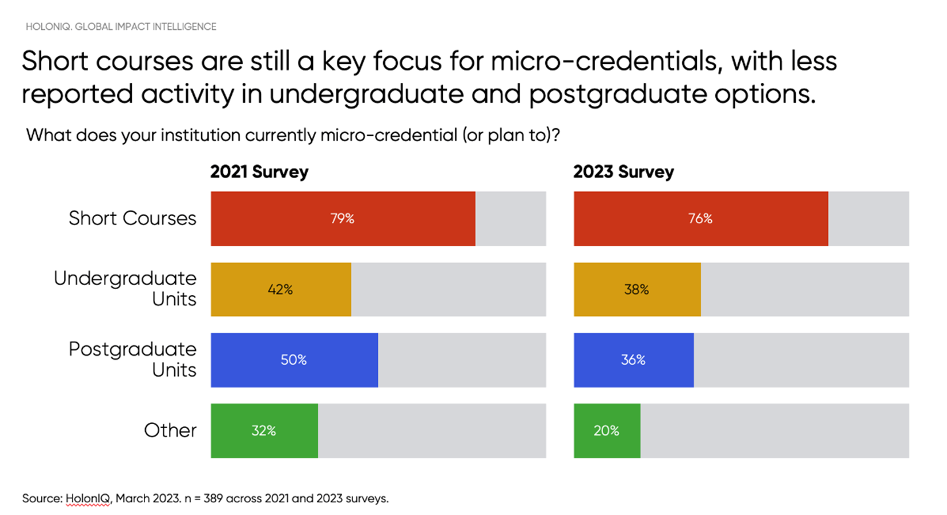
Short courses are the primary focus

Slide 25
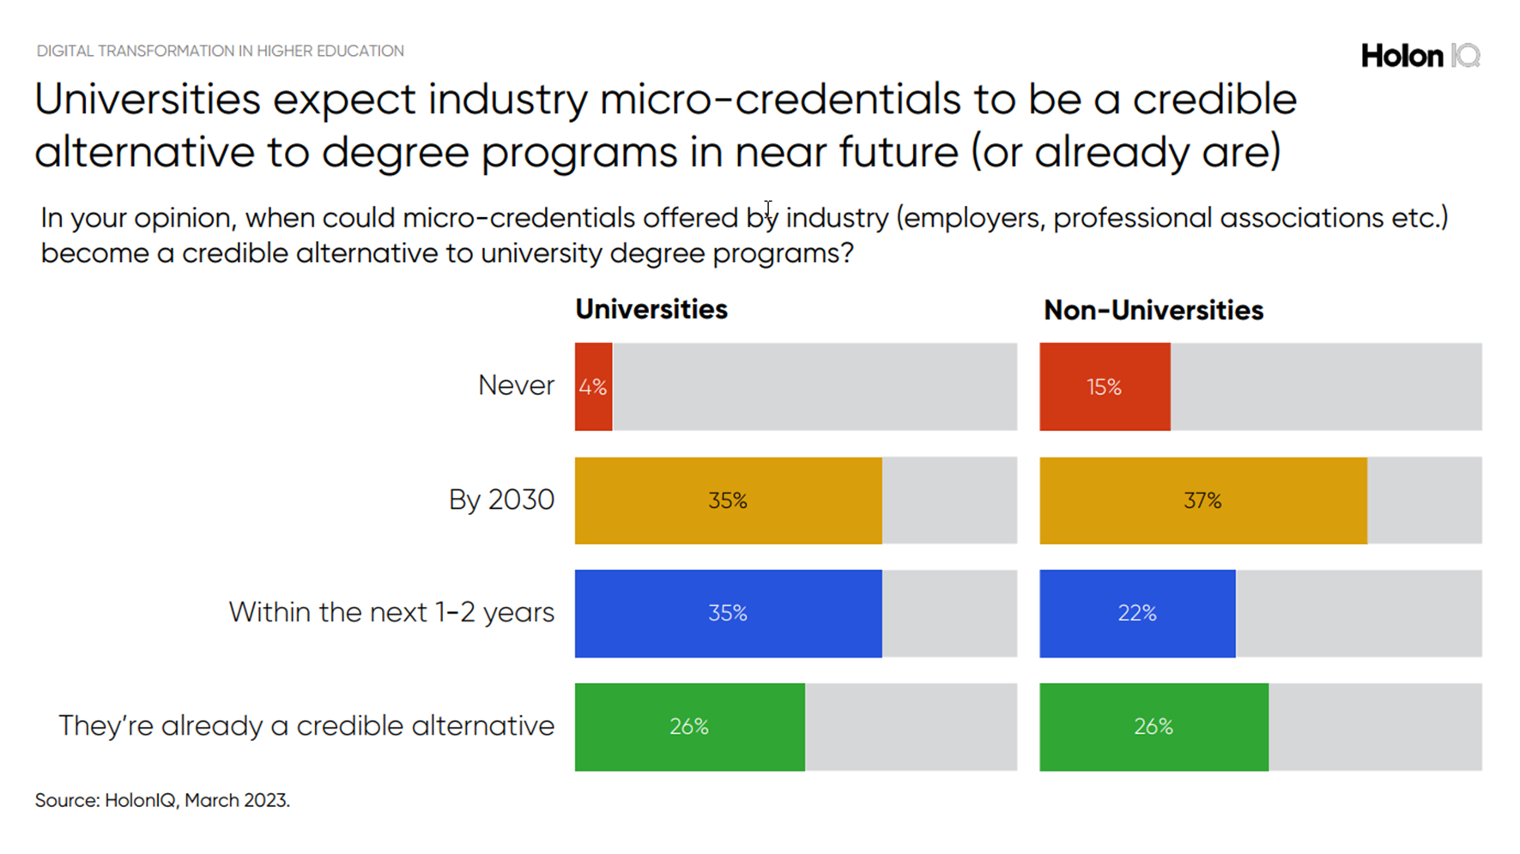

Slide 26
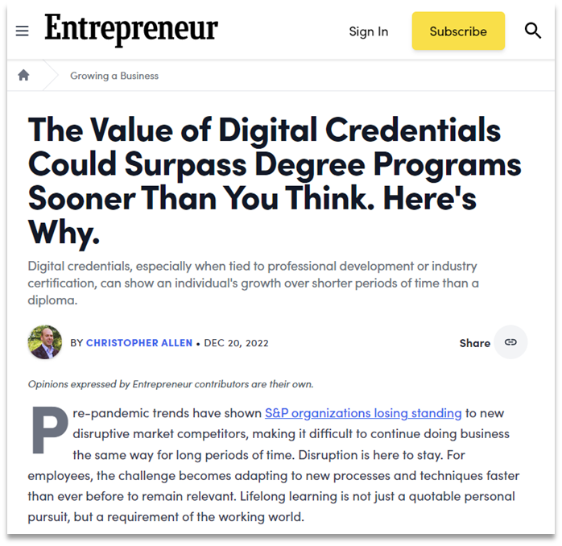

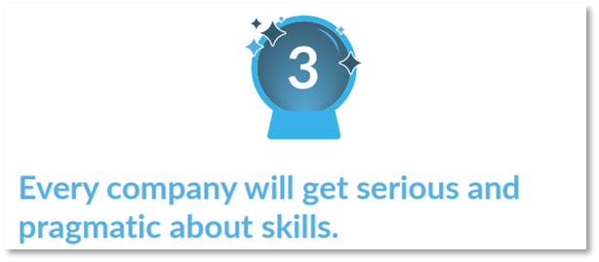
…and yet, your mileage may vary

Slide 27

Business moves to
Skills-based Talent
Notes:
Intro

Slide 28



36%
29%
of Millennials would spend more time learning if recognized by
their manager according to the
LinkedIn Learning Workforce report
of Millennial and Gen Z workers prefer "Learning and Development" over salary according to CNBC
14%
higher employee engagement, productivity and performance in organizations with recognition according to Deloitte
Notes:
Your defined goal when we spoke is to showcase client destination employer status to Gen Z and Millennials. First of all – what are Gen Z and Millennials looking for according to experts in the HR and talent fields?

Slide 29
Rise of the Skill-based Organization
5 global workforce shifts change everything
the automation of work
the
skills gap
the
skills shift
from roles to skills
Agile careers
1bn jobs will be transformed by technology in the next decade
68m jobs are
"algo-threatened" in the top 500 companies.
85m jobs may be unfilled by 2030 due to skills shortages, at a cost of $8.5tn
70% of execs see talent shortages as the most important driver for skills-based capabilities.
New technologies change in-demand skills.
The half-life of technical skills is shortening.
Robot-proof human skills will persist and differentiate.
Jobs can't keep up
Skill-sets for jobs changed 25% in 5 years.
Estimated to change 50% in the next 5 years.
Fluid careers are the new normal + the gig-economy & the "projectification" of work.
A generational increase in career switching : median tenure for 25-34 year-olds is 3.2 years.
1 in 5 workers expect to change jobs this year.
Sources: OECD, McKinsey Global Institute, Deloitte, PwC Global Workforce Survey, AlphaBeta/Google FutureSkills

Slide 30
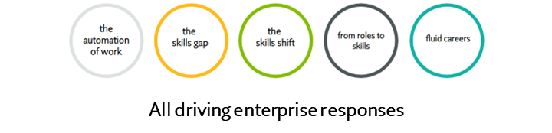
Human capital responses
Companies are gearing up for skills and humanizing human capital
ACTIONS MOST ORGANIZATIONS ARE TAKING
Investing in people analytics - Leveraging joined-up skills data across HR systems to know more about workers and work
Learning engagement aligned to skills – LXPs and other means to drive more learning hours with something for everyone
Deprioritizing degrees in favor of skills – for broader labor pools & expectations of 40%+ contingent workers
Employee experience and the "consumerization of L&D" – Workers increasingly valued stakeholders to organizational success. What matters to workers will matter more.
TRENDING ACTIONS (SOME ORGANIZATIONS, HIGH GROWTH)
Building a skills-based organization (SBO) – Skills as the “operating system” for recruitment, talent management, mobility
Focus on upskilling and reskilling to close gaps and secure talent: Amazon $1.2bn by 2025, Walmart $1b in 5 yrs...
Applied skill-building with learning in the flow of work and growing business leadership in L&D
Promoting and leveraging career pathways, matching employees to education for non-linear and adaptive careers
Measuring & recognizing skills with credentials to drive learning and showcase talent investment
Reverse recruiting – Proactively cultivating talent pipelines for “just in time” future access to valuable skills

Slide 31
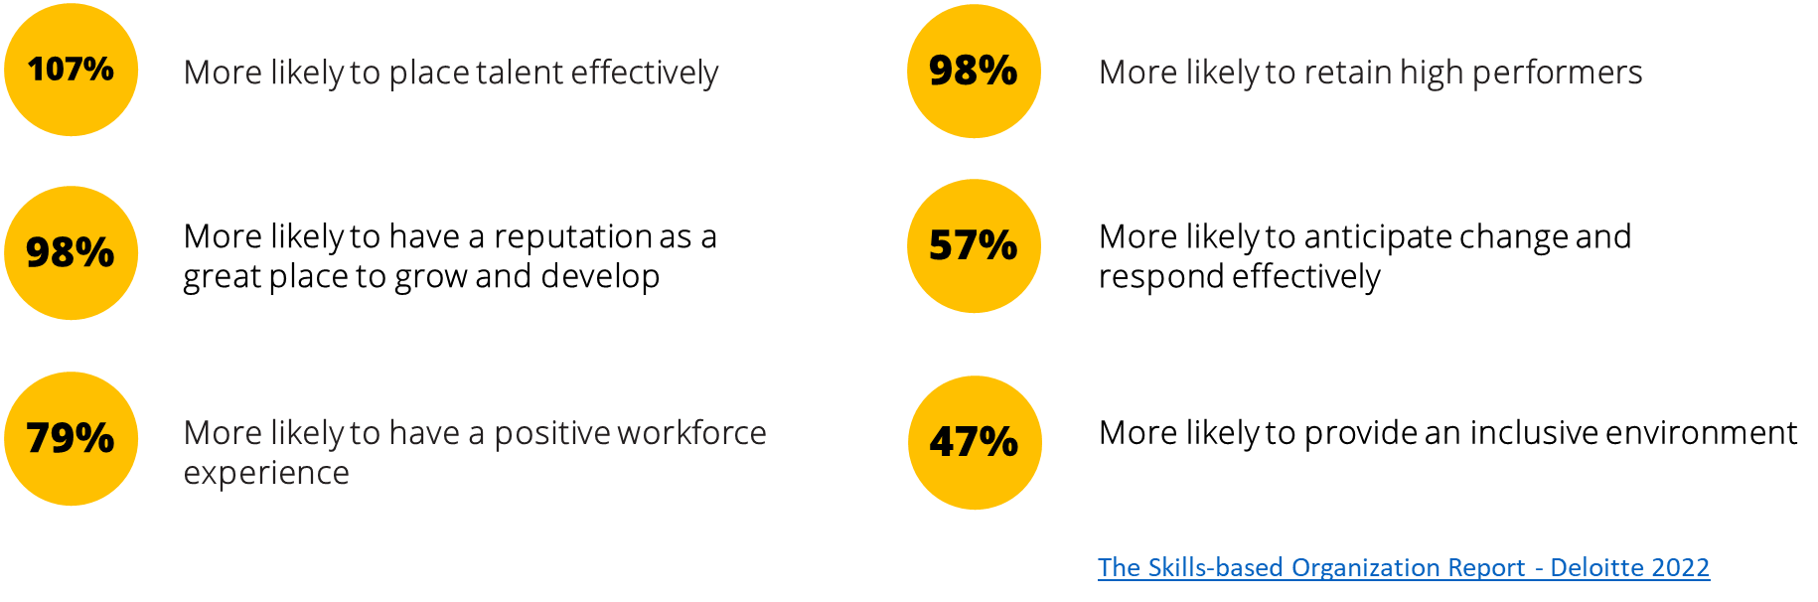
Rise of the Skill-based Organization
Moving the needle – Taking a skills-based approach
Skills-based organizations are:

Slide 32
Credentials are unlocking new opportunities

Slide 33
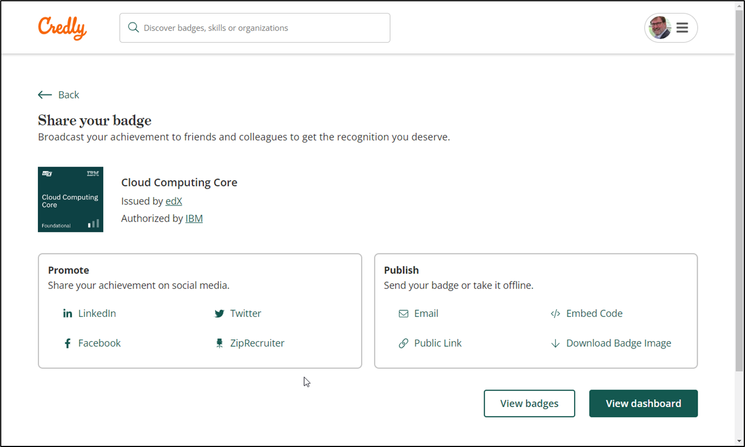
Where can I take my credentials?

Slide 34
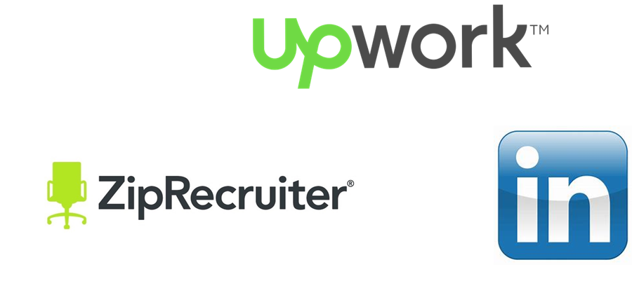

Where can my credentials take me?
Jobs, employment and careers
Finish my college degree / other educational goals

Slide 35

Problems to overcome

Slide 36
Obstacles for alternative credentials
Consistency & Completeness of data (full standard support, all metadata elements)
Terminology & Definitions – Especially Soft Skills
Full Standards Adoption
Value, quality and impact
Lack of common understanding about alt credentials
Regional alignment between employers and Higher Education
Tech platform support (HR Systems, Registrar records)

Slide 37

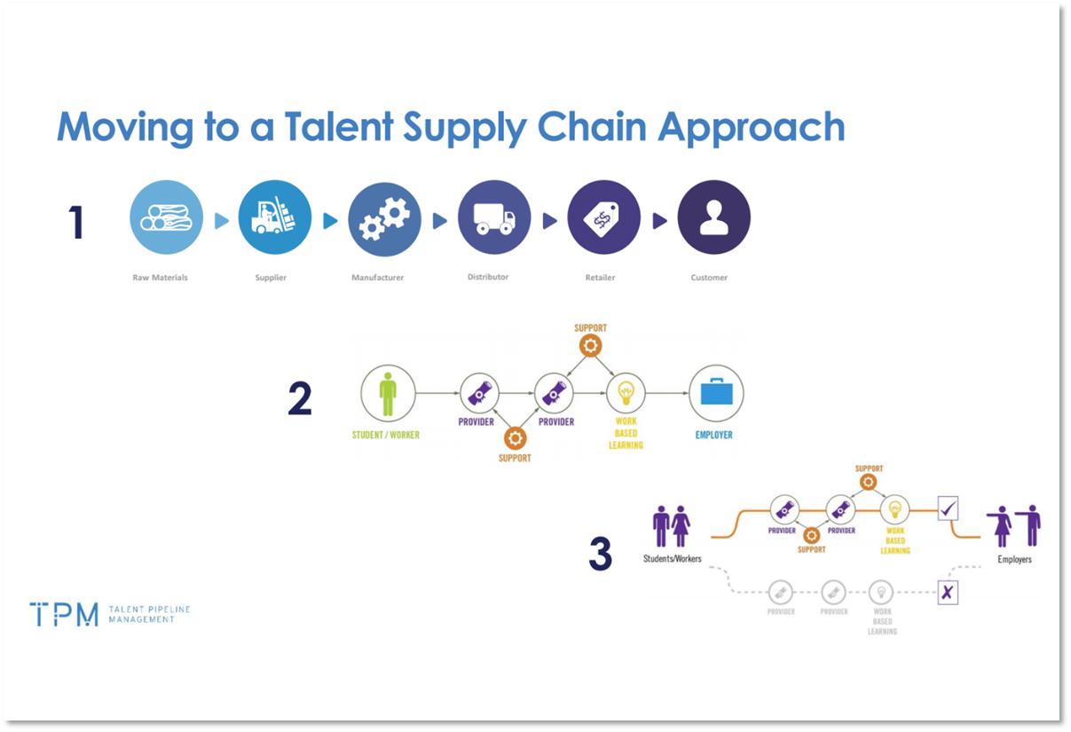
Strategies for engagement: Talent Supply Chains

Slide 38

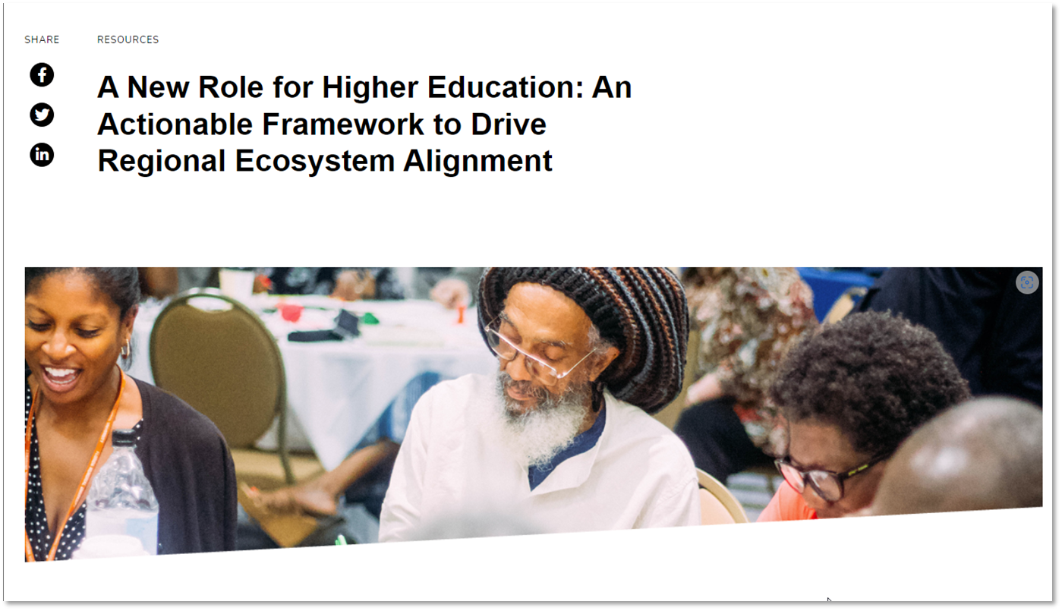
Strategies for engagement: Regional ecosystems

Slide 39
Q&A

Slide 40
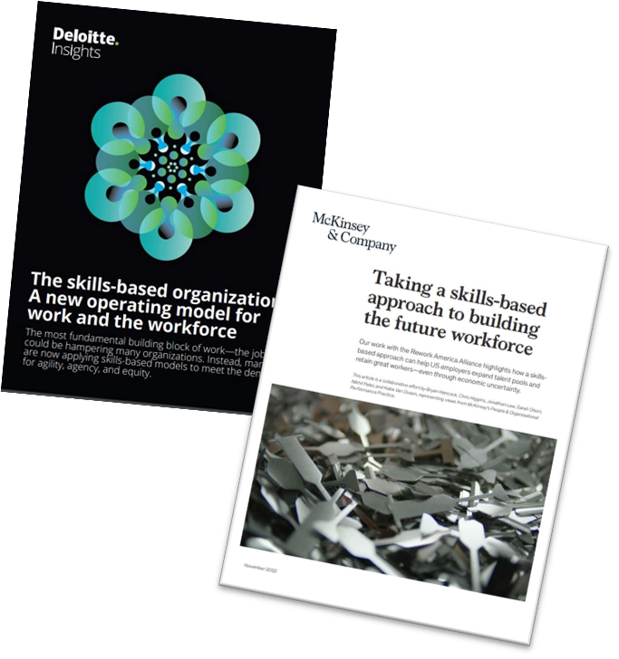
Resources
Deloitte - The Skills-based Organization A New Operating Model for Work and the Workforce
McKinsey - Taking a Skills-based Approach to Building the Future Workforce
LinkedIn Learning - Workplace Learning Report
CNBC - What Gen Z and Millennials want from Employers Amid the Great Resignation
Deloitte - Recognition Programmes - Are They Important?
IBM Blog - Do Digital Badges Really Provide Value to Businesses?
Credly Case Study on PVH - Creating A Culture of Learning Across Global Brands
Credly Case Study on Grant Thornton - A Professional Services Firm Transforms into a Skills-based Organization
Faethm Case Study on Zurich Insurance - Available Upon Request
Forbes - How Digital Badges Motivate and Engage Learners - the Kellogg Company
HolonIQ, Micro-Credentials Survey: 2023 Insights
Education Design Lab, Framework to Drive Regional Ecosystem Alignment
US Chamber of Commerce Foundation, Talent Pipeline Management

Slide 41
Want to learn more?
The Credly by Pearson team will be at the UPCEA conference next week in DC!
Come and say hello at booth 113.

Slide 42
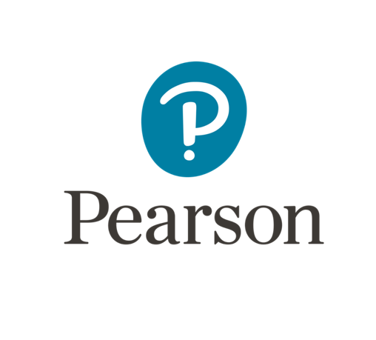
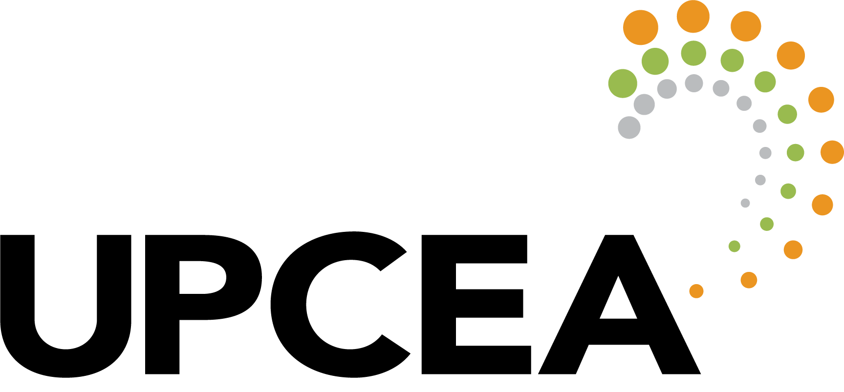
End of Presentation
Notes:
Closing Slide

